Slide 1
The Co(n)incidence of Poetry ‘n’ Translation
Chris Tanasescu (MARGENTO)

Slide 2
A Bit of Fortunetelling
Start with a digression… (digressus, past participle of digredi "to go aside, depart“)… Andre Breton: “Detour par essence…”
Co-incidence or ac-cident; -cidere, comb. form of cadere "to fall“… in Romanian: cădere; for coincidence we have both coincidență and întâmplare; what is the difference?
În-tâmpl-are; intemplare; from the ancient auspices performed in temples by augurs; not ogres; nor augers!
Auspice: observation by an augur especially of the flight and feeding of birds to discover omens…
Augur: 1: an official diviner of ancient Rome; 2: one held to foretell events by omens

Slide 3
A Bit of Fortunetelling and… Translation
The augur translates what (s)he sees into predictions; (s)he reads omens and foretells the future.
Augur is related to augmentation; may bring about an increase in crops; an increase in texts? Is there an agri-culture of translation?
Augur also related to garrire, to talk [>En. garrulous]; in Romanian, gură, mouth;
Is the translator an augur? The geometric meaning of translation; the geo-metry of birds’ flight in a temple; in a template; hence,
The discourse on transport within a template performing augmentation and prediction (an [in]augural definition of translation; auspicious too?…)

Slide 4
Words not as Building Blocks, but…
Transport means metaphor; so is poetry related to translation? Poetry is translation. “Poetry, thy name is infinity by translation” (PI, https://pionline.wordpress.com/2010/03/01/guest-writers-series-5-chris-tanasescu/)
Translation of emotions and thoughts into words? [Yuck!!! ☺]
Emotions, meaning[s], are not a given, no datum/a, they are expressed as impressed;
Words are not building blocks; but yielding stocks…
Stock as in stock phrase…; (not laughing stock but livestock ☺;) also stocks as in stock market assets or shares at the stock exchange; but perhaps most intriguingly as in…

Slide 5
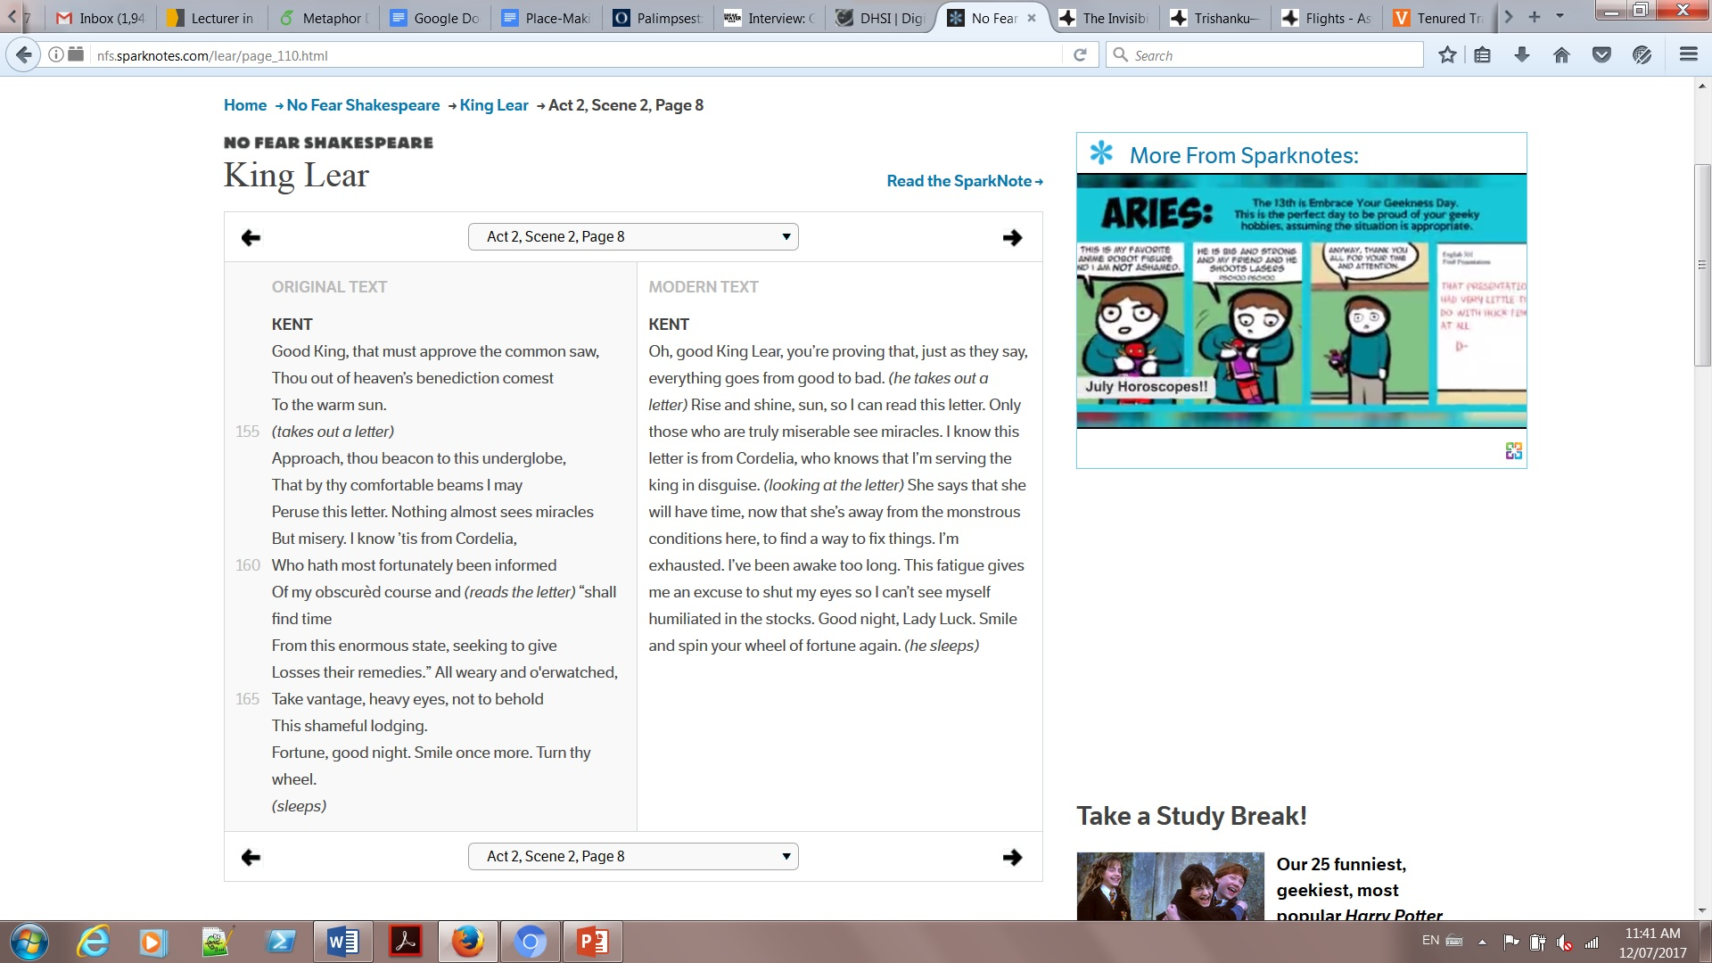
… Yielding Stocks
stocks as in the former instrument of punishment…
http://nfs.sparknotes.com/lear/page_110.html

Slide 6
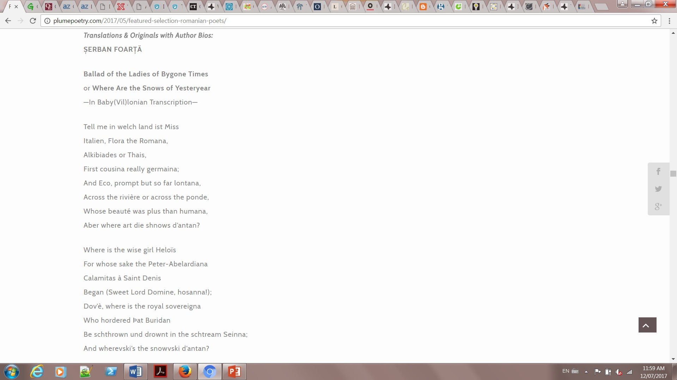
Translation within the same language; translation within the same text… http://plumepoetry.com/2017/05/featured-selection-romanian-poets/

Slide 7
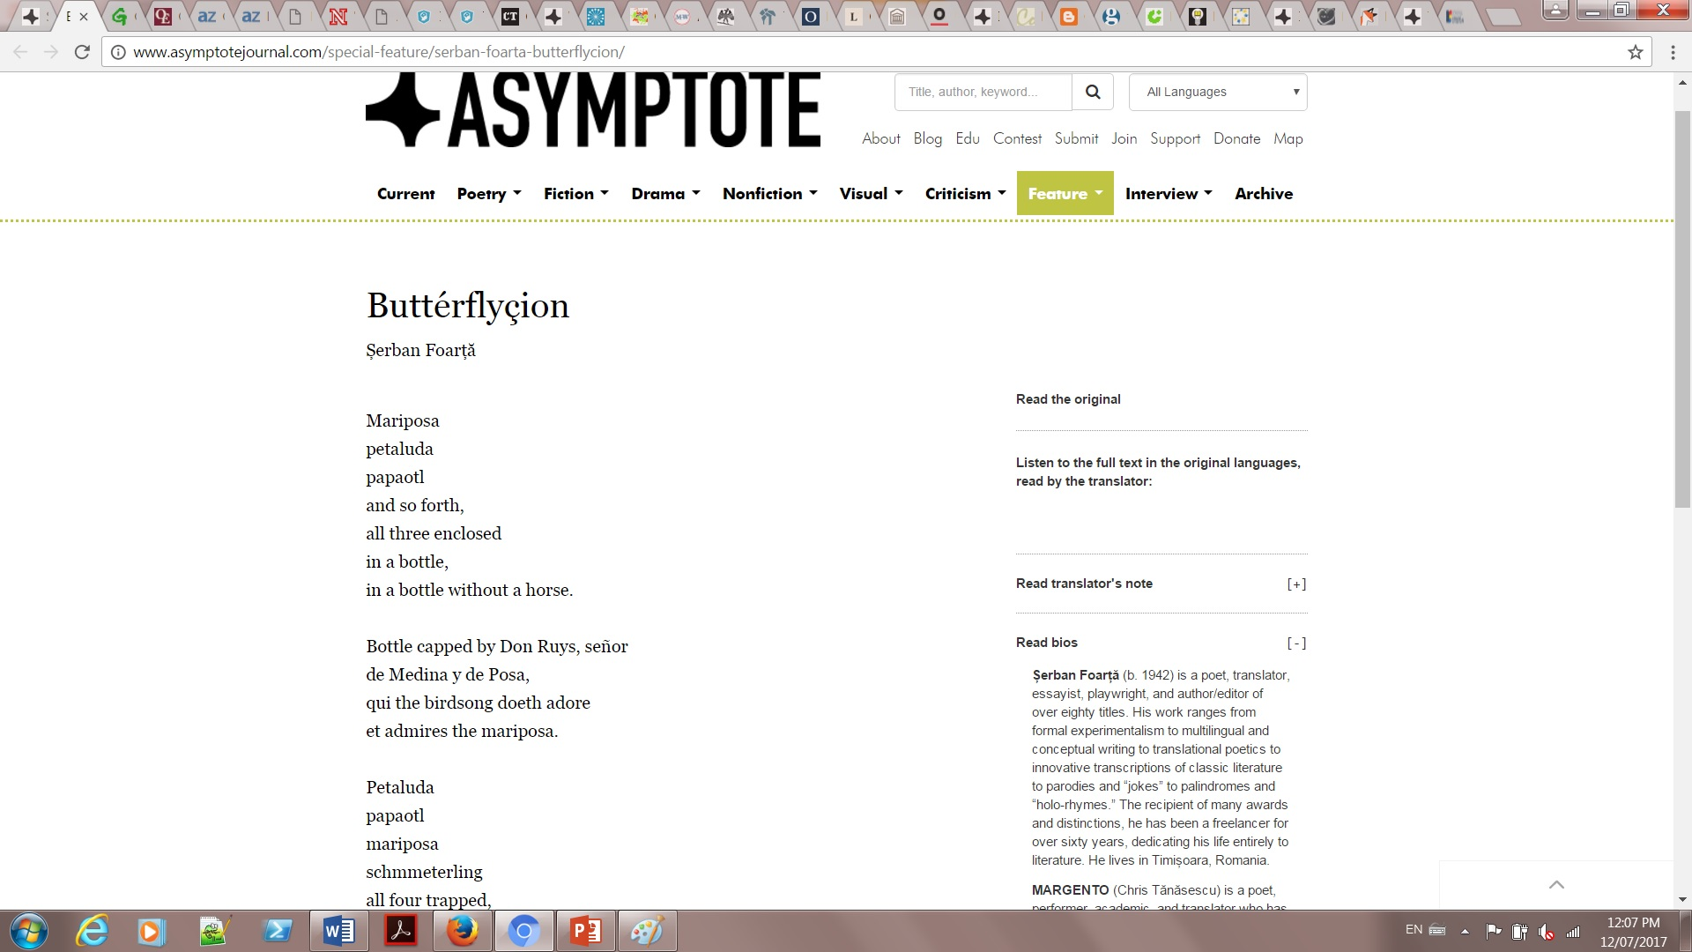
All Poetry Is Translation and Multilingual Writing
There’s no original; all languages are multilingual; there's nothing that hasn't been translated, mediated. http://www.asymptotejournal.com/special-feature/serban-foarta-butterflycion/
“Șerban Foarță’s ‘Papillonage’, the issue’s most ostentatiously multilingual piece. As well as being a poet (and essayist, translator, editor, and playwright…), Foarță is a renowned writer of song lyrics. His translator MARGENTO’s wonderfully exuberant rendition of the poem foregrounds that musicality, allowing us to hear the way the different languages twist and bend around one another, as well as drawing on his own experimentations with multimedia cross-artform performance.” (Ellen Jones, Criticism Editor, Editor of the Multilingual Feature)

Slide 8
Multiple and Manifold Multitudes
Waly Salomão “Poema Jet-Lagged” http://www.asymptotejournal.com/poetry/waly-salomao-jetlagged-poem/
Walt Whitman’s “I contain multitudes.” Has been read as in the Baudelairean sense, “multitude--solitude.” Still can also be read as multitudes of languages; formalized ones as well perhaps; let’s revisit the whole quote...
“Do I contradict myself?/ Very well then I contradict myself,/ (I am large, I contain multitudes.)”
The multitude of selves, multitude of languages, multitude of translations, multitude of mobilities and inter-connections; the very sensorium involved in/enacted by the poem becomes mobile, translational, multimodal, and multimedial.

Slide 9
Dealing with, Absorbing, and Issuing Multitudes
A decade ago I realized I needed a mathematically n digitally inflected method for my own writing, translation work, and editing. For 2 reasons:
1. to internalize the (post)digital condition, new media, and more recently, what is beyond new media, polymediation, and the polymediated condition,
2. to respond to, express, and internalize the challenges of big data.

Slide 10
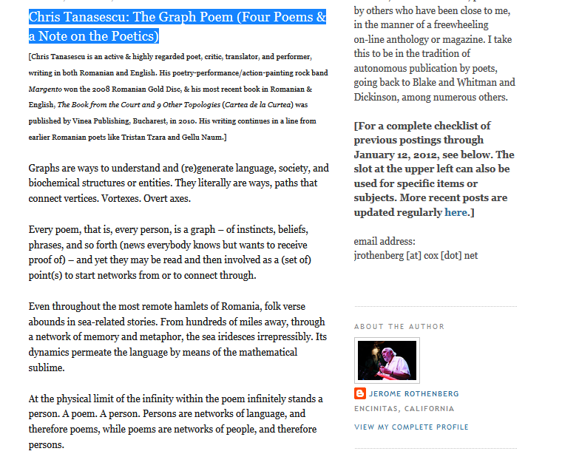
The Graph Poem
Applying graph theory and various related applications in poetry writing/translation/performance and analysis/processing.
First statement: http://poemsandpoetics.blogspot.ca/2011/03/chris-tanasescu-graph-poem-four-poems.html

Slide 11
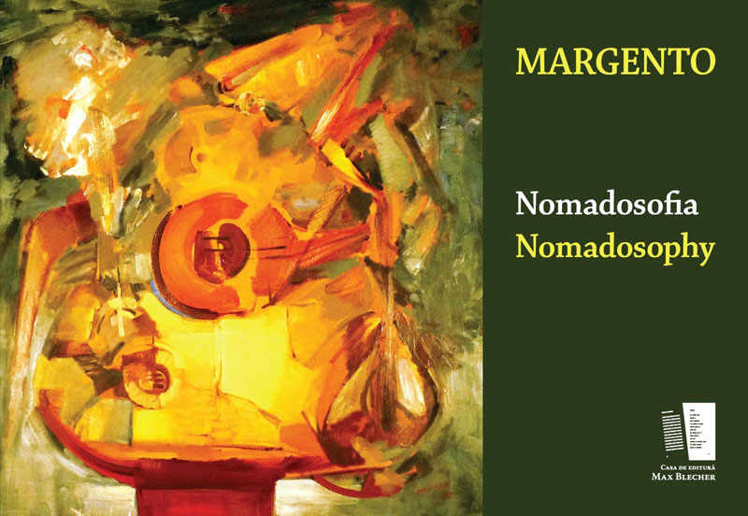
A Manually Assembled Graph Poem
MARGENTO. (2012). Nomadosofia (poem graf) /Nomadosophy (a graph poem). Max Blecher Press.

Slide 12
MARGENTO—Nomadosophy
"Margento is a caravan, a circus, a symphony, and a brawl. It is a global, multi-languaged, powerful performance troupe made of more than fifty poets (from Darwish to Ly Doi, Levine to Ng to Oeur) working in a brand-new kind of theater. And its conductor, impresario, and visionary puppet-master is the brilliant Romanian poet and performer Chris Tanasescu. In his hands, in his head, and with his orchestration, poetry comes vitally alive in a shared, communal, polyphonic, and charged new way - rich with political aptitude and buzzing with lyrical pizzazz - as it seeks to remember our many origins, roaming on toboggans, fishing boats, and taxicabs alike, and searching for a place for the night. Songs alongside footnotes, tiny imagist poems loaded like bombs inside rangy prose documents, lyrics within dramatics within call-and-response meta-texts, the four primary "poems" of Nomadosofia cover the globe with poetry that leaps over borders, from erotic to elegiac, holy to profane, formal to wildly improvised, ancient yet as new as the latest zip-drive. If you want to hear a poetry as representative, as capacious, and as timely as is humanly possible, turn on Nomadosofia and, I predict, soon you'll be singing along. Everyone's welcome." David Baker

Slide 13
Enter: Computer Science & Digital Humanities
Topic classifier: “Multilabel Subject-Based Classification of Poetry.” Andrés Lou, Diana Inkpen, and Chris Tanasescu (Margento) (2015) http://www.aaai.org/ocs/index.php/FLAIRS/FLAIRS15/paper/viewFile/10372/10322
Meter and rhyme: “Automatic Classification of Poetry by Meter and Rhyme.” Chris Tanasescu (Margento), Bryan Paget, and Diana Inkpen (2016) www.aaai.org/ocs/index.php/FLAIRS/FLAIRS16/paper/download/12923/12883
Metaphor detection and processing soon to be presented @ ACL 2017: co-authored with Vaibhav Kesarwani, Diana Inkpen, and Stan Szpakowicz https://sighum.wordpress.com/events/latech-clfl-2017/accepted-papers/
Rhyme classifier and visualization app: Vaibhav Kesarwani
“Access(ed) Poetry. The Graph Poem Project and the Place of Poetry in Digital Humanities” @ DH2017

Slide 14
A Number of Coincidences? Or… intamplare?
Franco Moretti, Distant Reading, 2006
“the great unread” and [no such thing as] world literature(s)
“Transcending the Document Paradigm in DH” by Schloen & Schloen, in DHQ, 2014
Data intensive and corpus-based research
The Graph Poem (beyond any “coincidence”):
Developing corpus-poetry and the corpus-poem; the corpus as poem and the poem as corpus; the poem-corpus as database;
The poem not as extraction from, but as diving into and expansion of the database; the latter represented and analyzed as a network graph

Slide 15
A Coincidence of No Incidence…
In 2008 MARGENTO the band released an act titled “Hora Asymptotica”…
3 years later, Asymptote launched its first issue, and soon…
…that is, 1 year later, “Asymptotica” was on Asymptote, http://asymptotejournal.tumblr.com/post/25223463160/hora-asymptotica-by-margento-an-animated-picture
Why no incidence? Still, întâmplare?
The Graph Poem as a network of flowing impulses and responses whereby the translation within a poem spills over into the other poems and languages across the ever-growing corpus.

Slide 16
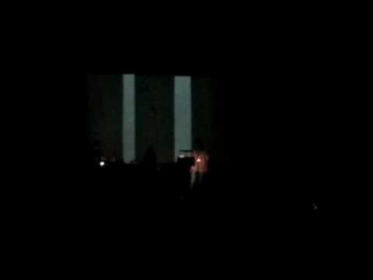
The Graph Poem as Cross-artform Performance-Translation
https://www.youtube.com/watch?v=TXLbPj38MUY

Slide 17
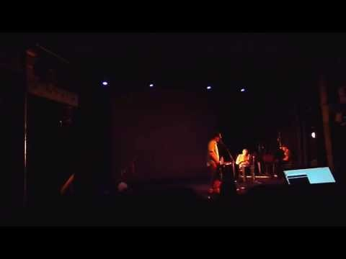
The Graph as Inter(-Re)Mediated (Post)Digital (Re)Performance Poetry
The Electronic Poetry Conference, Kingston U, London, 2013
Re-performance and re-enactment involving re/dis-placement & remediation that translates the graph poem as a processual corpus into postdigital negotiations, alternations, and con-fusion(s) between real and documented, between the artificially (and therefore mediated) “unmediated” and successive layers/stages of gradated and hybridized inter(-and-re)-mediation. https://www.youtube.com/watch?v=NJ2G_4OmJ_c

Slide 18
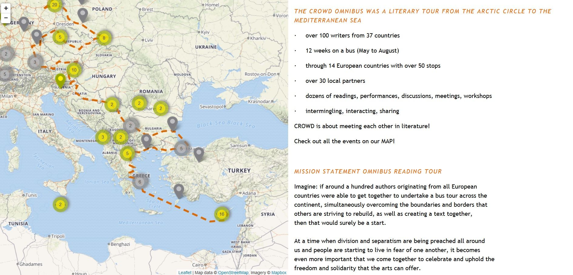
CROWD (CReating Other Ways of Dissemination) Omnibus Literary Tour (2016) http://crowdlitbus.eu/#/start

Slide 19
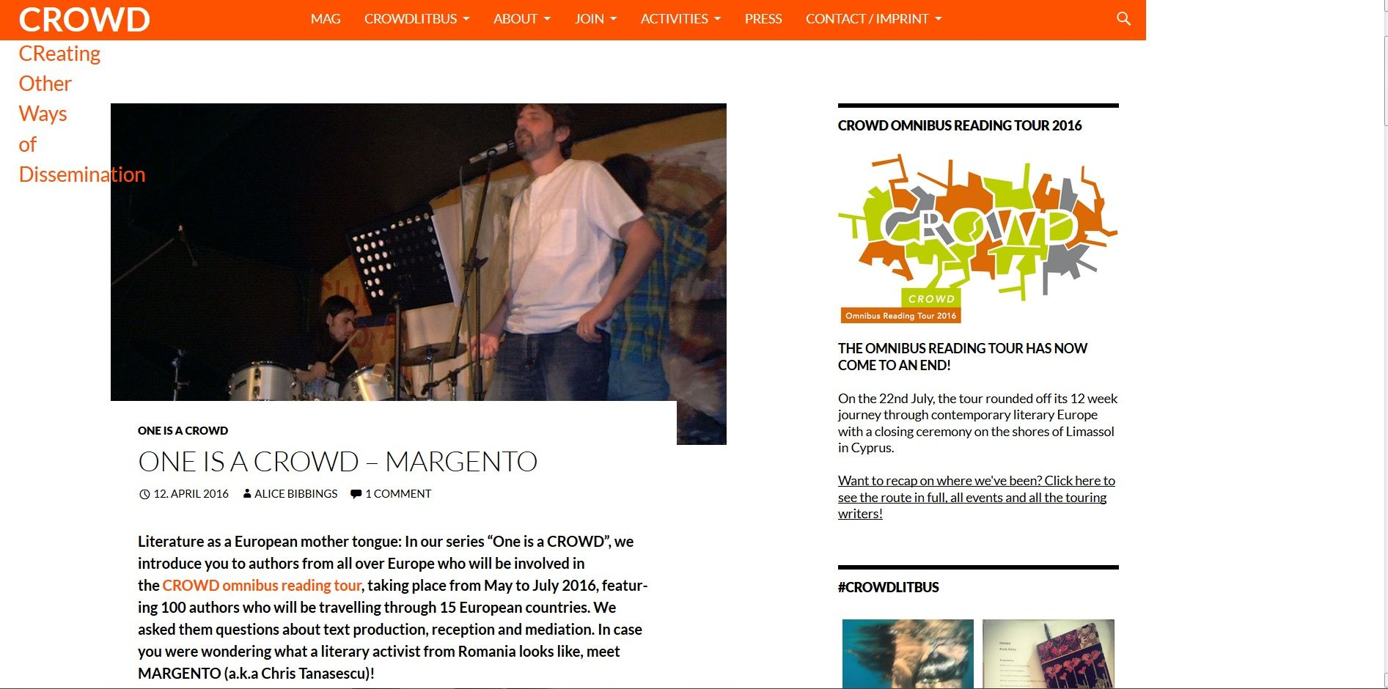
CROWD http://crowd-literature.eu/one-is-a-crowd-margento/

Slide 20
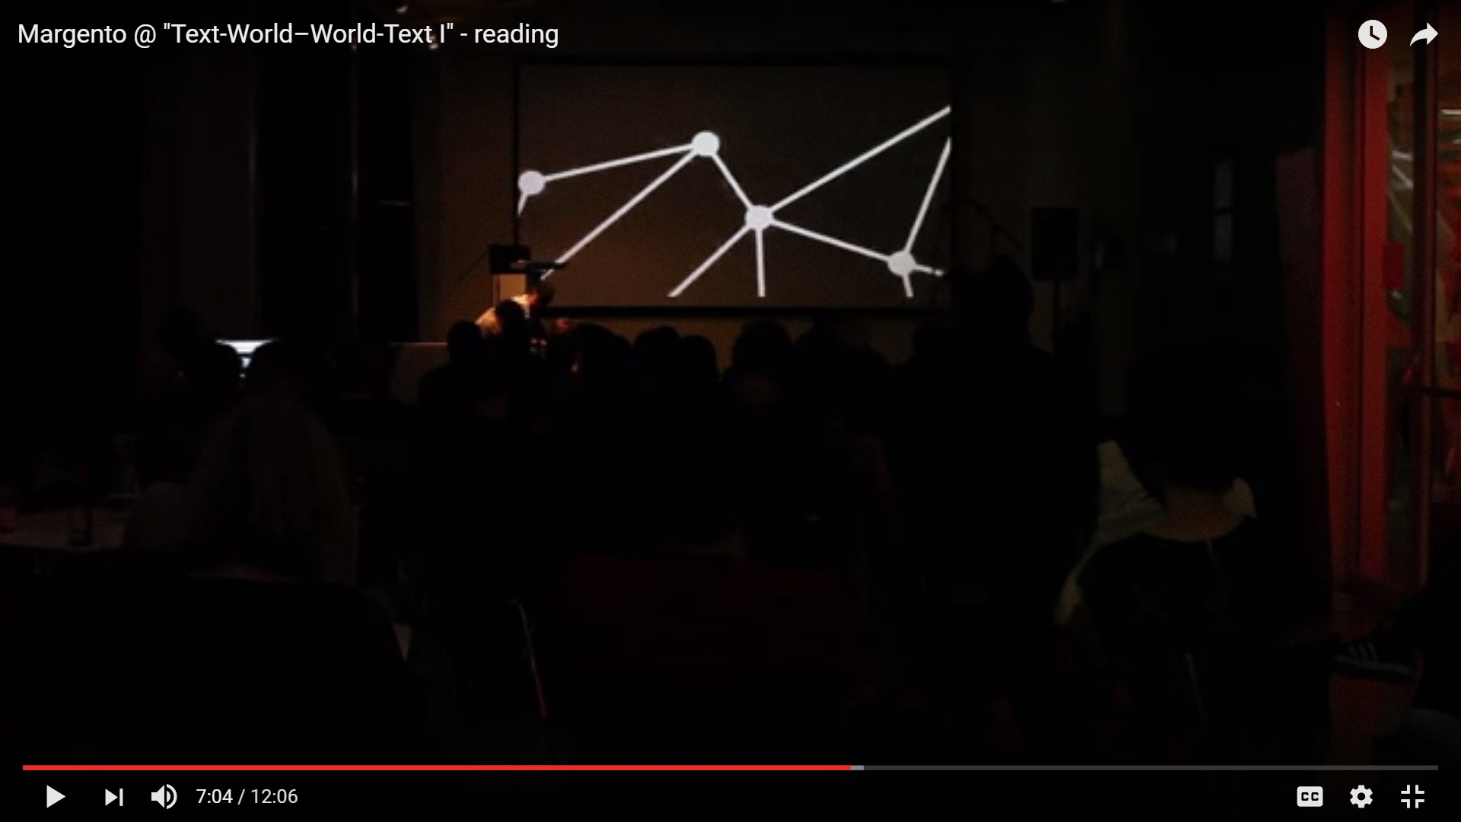
Margento @ "Text-World–World-Text“ in Graz
https://www.youtube.com/watch?v=Bkdi6kGOkx0

Slide 21
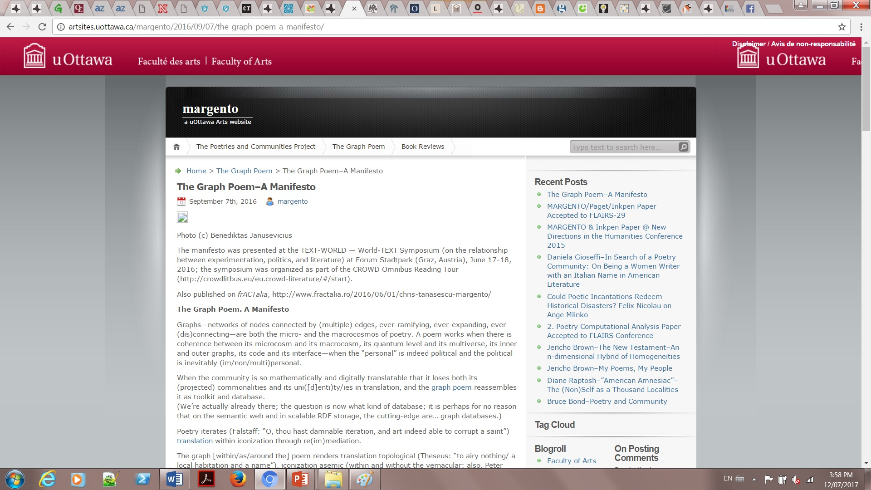
A Manifesto
http://artsites.uottawa.ca/margento/2016/09/07/the-graph-poem-a-manifesto/

Slide 22
Thank you! ☺
Questions?
http://artsites.uottawa.ca/margento/en/

